Slide 1
Hypothetical Testing

Slide 2
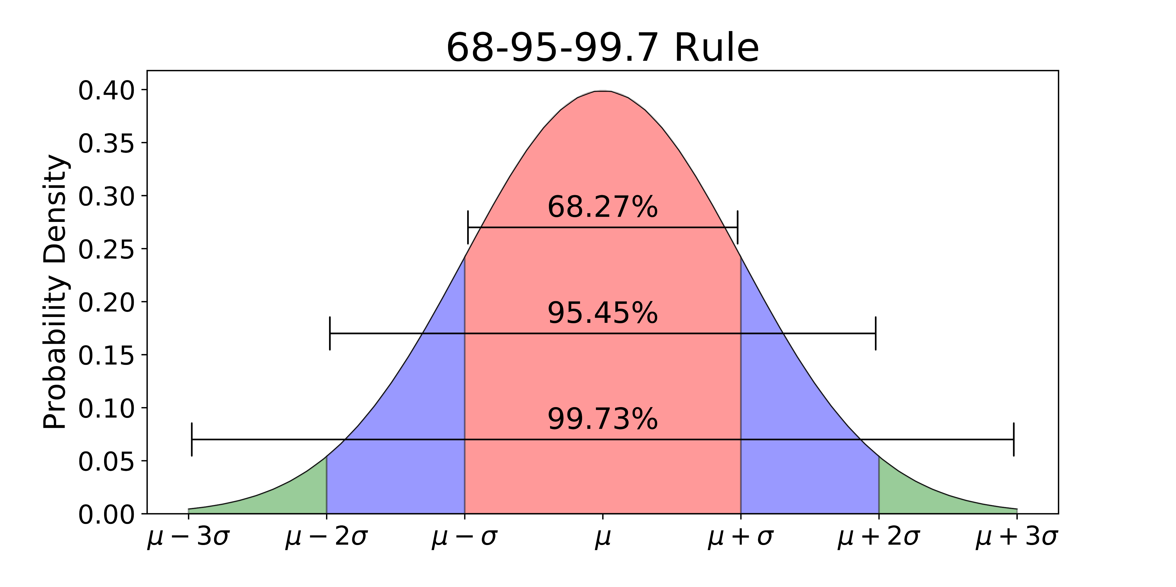

Slide 3
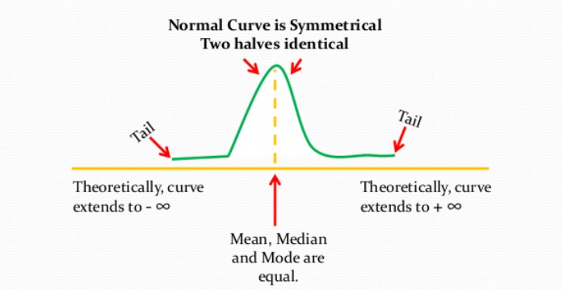

Slide 4
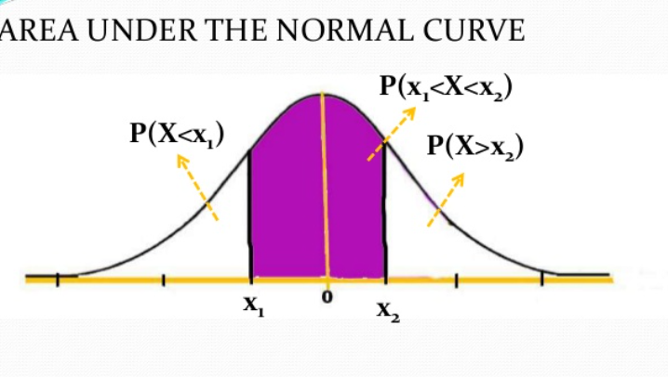

Slide 5
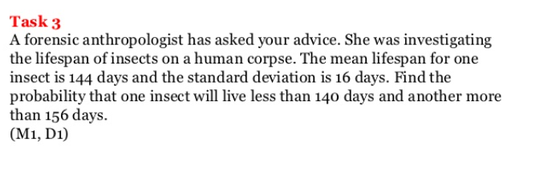

Slide 6
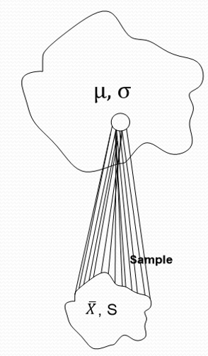
Hypothesis and Statistical Inferences
The main purpose of Statistics inference is to make an accurate conclusion using a limited sample about a greater population.
hypothesis testing uses point estimate to decide which of two hypotheses (guesses) about parameter is correct.

Slide 7
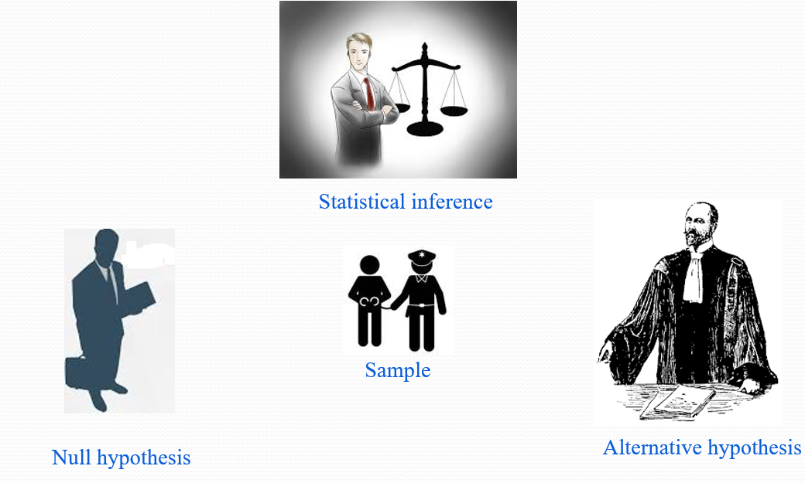
Null Hypothesis is default position or default mean of population
Alternate hypothesis is which we are comparing

Slide 8

Example: Titanic
The ship Titanic sank in 1912 with the loss of most of its passengers
809 of the 1,309 passengers and crew died
= 61.8%
Research question: Did class (of travel) affect survival?
Notes:
Ask the audience what the null and hypothesis might be, what type of data we would have and what test we should consider using.

Slide 9
Chi squared Test?
Null: There is NO association between
class and survival
Alternative: There IS an association between
class and survival
3 x 2
contingency table
Notes:
Since we have two categorical variables and want to know if they are associated we can use a chi-squared test. Class could be considered as an ordinal variable but there are only 3 levels here and so a chi-squared test therefore be quite appropriate. Point out there are 3 rows and 2 columns in our table and hence this is called a 3x2 contingency table. Discuss whether the table suggests class and survival are connected and try to tease out that we might be better looking at the % of 1st class passengers that died/survived and compare this with the % for 2nd class and 3rd class.

Slide 10
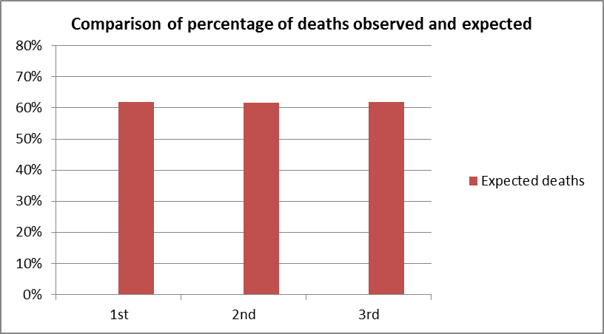
What would be expected if the null is true?
Same proportion of people would have died in each class!
Overall, 809 people died out of 1309 = 61.8%
Notes:
Discuss that this is what the % would be if there was no difference between the classes with respect to the chances of survival.

Slide 11
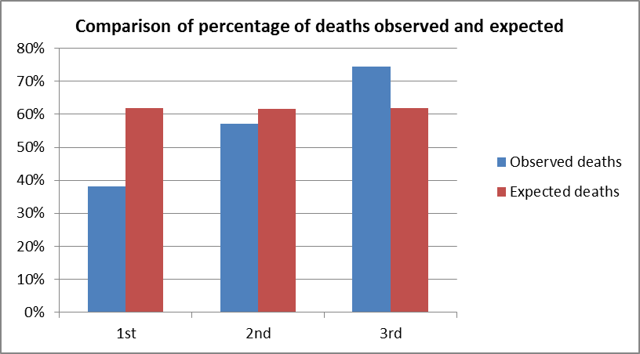
What would be expected if the null is true?
Same proportion of people would have died in each class!
Overall, 809 people died out of 1309 = 61.8%
Notes:
These show the % that were OBSERVED deaths in each class and are compared with the EXPECTED % shown in the previous slide. Discuss how the observed % for 1st class is the lowest whilst 3rd class is the highest.

Slide 12
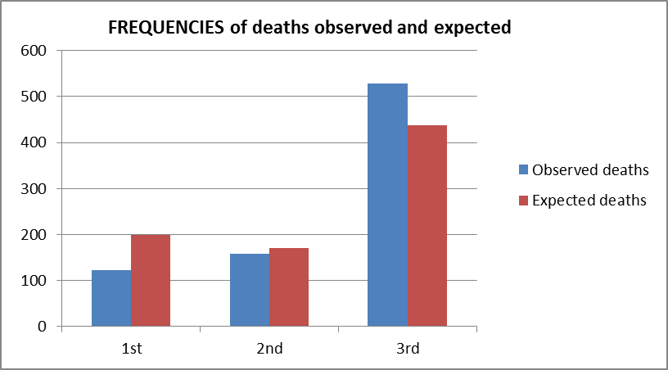
Chi-Squared Test Actually Compares Observed and Expected Frequencies
Expected number dying in each class = 0.618 * no. in class
Notes:
This slide is shown since the chi-squared test formally compares the observed FREQUENCIES with the expected frequencies.

Slide 13
Steps to Perform Hypothesis Testing
Finding Null Hypothesis(H0) and Alternative Hypthesis(H1)
Specifying Confidence interval or Level of Significance
Apply test statistic
Looking into statistic table to compare obtained value and p value
Proving Null Hypothesis is rejected or Accepted
At alpha value, Pvalue< calc value =>REJECT H0
p-value > calc Value=> Retain H0

Slide 14
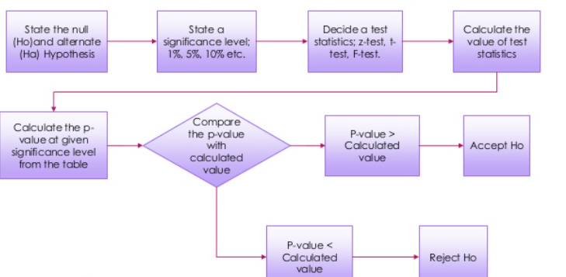

Slide 15
Old System Vs New System
old System
In Preparing 100 screws
screws probability
95/100 -> 0.49
94/100 -> 0.32
93/100-> 0.10
92/100-> 0.5
New System
In Preparing 100 screws claims
screws probability
95/100 -> 0.55
sample 100 -> 92

Slide 16

α
H₀: μ ≥ 3 H₁: μ < 3
Rejection Regions
0
α
H₀: μ ≤ 3 H₁: μ > 3
0
α/2
H₀: μ = 3 H₁: μ ≠ 3
0

Slide 17
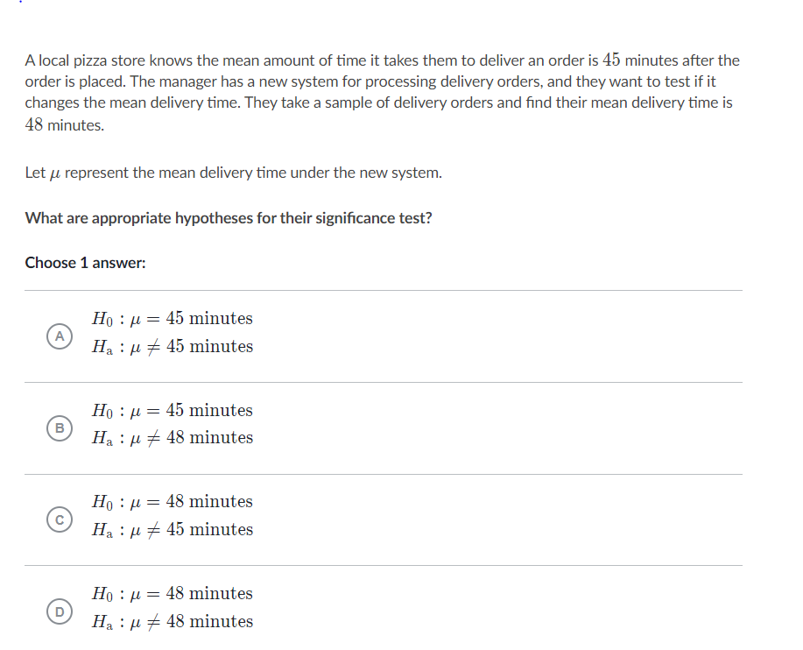

Slide 18
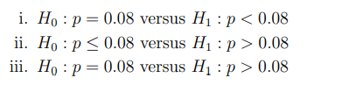
In a battery factory, 8% of all batteries made are assumed to be defective. Technical trouble with production line, however, has raised concern percent defective has increased in past few weeks. Of n = 600 batteries chosen at random, 70 of them are found to be defective. Does data support concern about defective batteries at α = 0.05?

Slide 19
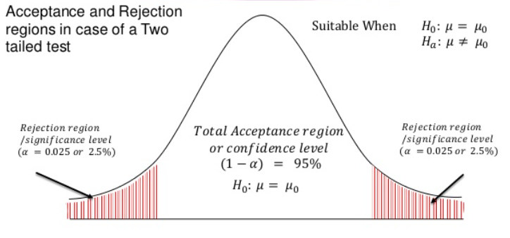

Slide 20
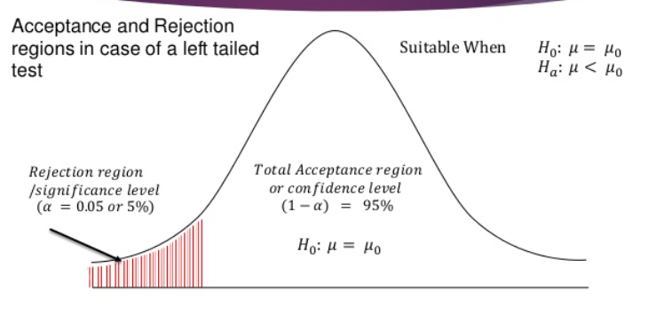

Slide 21
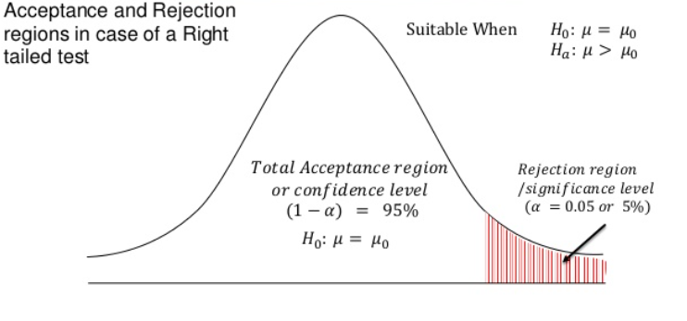

Slide 22
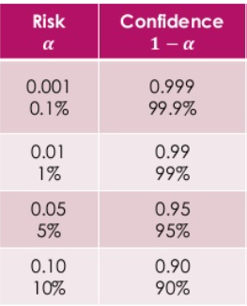
Level of Significance
The significance level, also denoted as alpha or α, is a measure of the strength of the evidence that must be present in your sample before you will reject the null hypothesis.
The researcher determines the significance level before conducting the experiment.
The significance level is the probability of rejecting the null hypothesis when it is true. For example, a significance level of 0.05 indicates a 5% risk of concluding that a difference exists when there is no actual difference.
Lower significance levels indicate that you require stronger evidence before you will reject the null hypothesis.

Slide 23
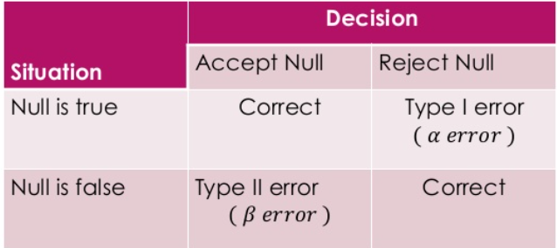
Alpha error is because of sample error, your calculated p-value that is less than significance level, you get excited because your results are statistically significant.
your calculated p-value is greater than significance level, your results are not statistically significant.
Beta error is because of small sample size, high data variability

Slide 24
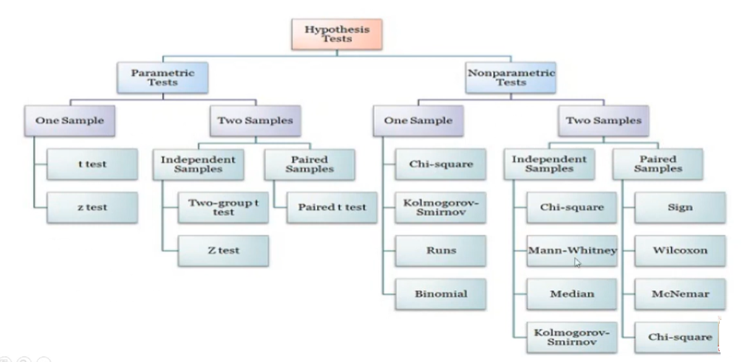

Slide 25
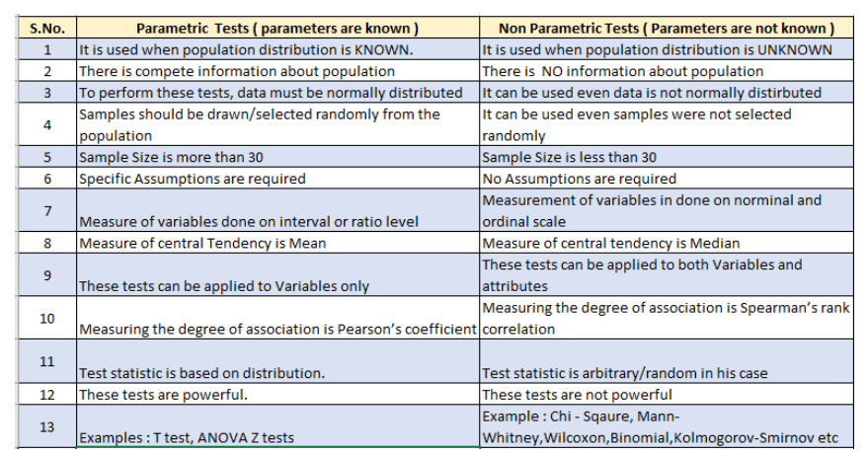

Slide 26
T-Test
Assumptions
Population is normally distributed
If not normal, only slightly skewed & a large sample taken
Parametric test procedure
t test statistic

Slide 27
T- test for single mean
The following are the weight (mg) of each of 20 rats drawn at random from a large stock. Is it likely that the mean weight for the whole stock could be 24 mg, a value observed in some previous work?.
9 18 21 26
18 22 27
19 22 29
19 24 30
16 20 24 32

Slide 28
Steps for test for single mean
Questioned to be answered
Is the Mean weight of the sample of 20 rats is 24 mg?
N=20, =21.0 mg, sd=5.91 , =24.0 mg
2. Null Hypothesis
The mean weight of rats is 24 mg. That is, The sample mean is equal to population mean.
3. Test statistics --- t _{(n-1)} df
4. Comparison with theoretical value
if tab t _{(n-1)} < cal t _{(n-1)} reject Ho,
if tab t _{(n-1)} > cal t _{(n-1)} accept Ho,
5. Inference

Slide 29
t –test for single mean
Test statistics
n=20, =21.0 mg, sd=5.91 , =24.0 mg
t_{α} = t _{.05, 19} = 2.093 Accept H₀ if t < 2.093 Reject H₀ if t >= 2.093
Inference :
There is no evidence that the sample is taken from the population with mean weight of 24 gm

Slide 30
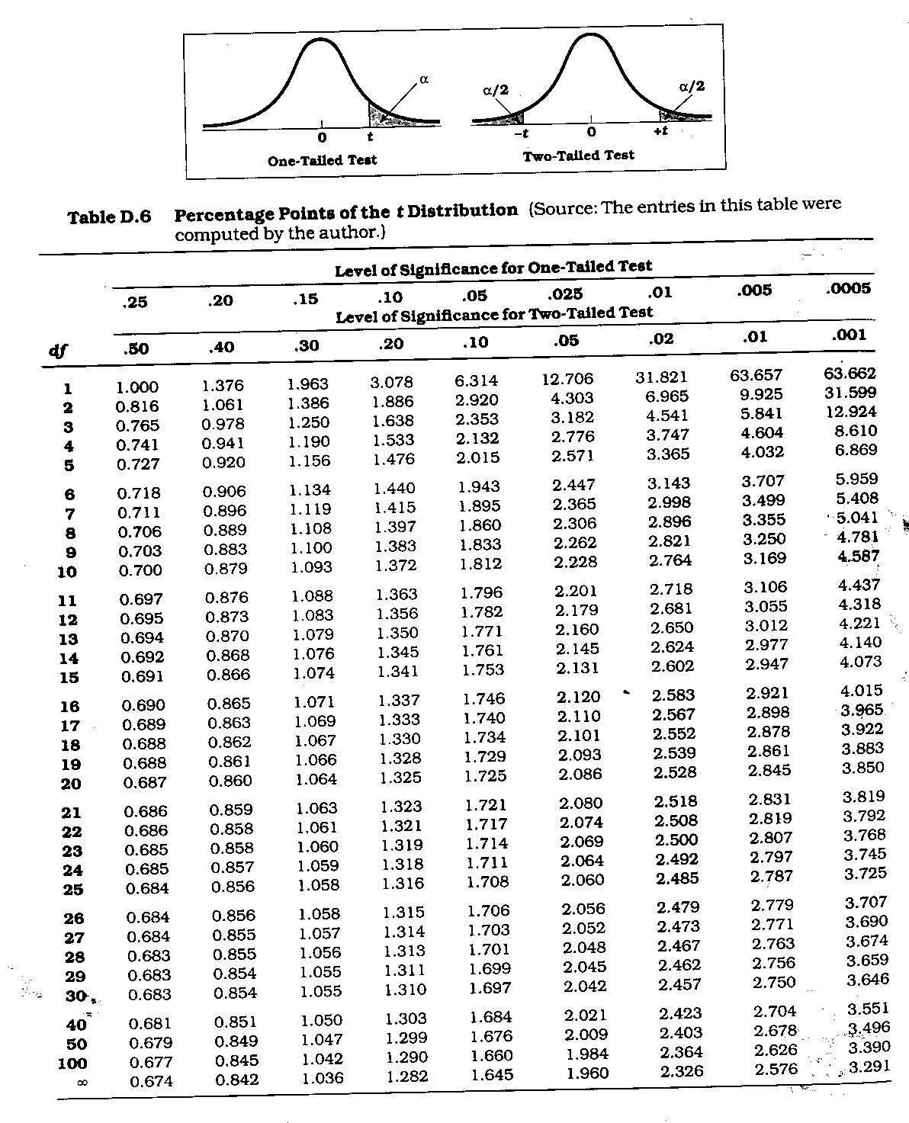

Slide 31
T-Test
Clients Participation in therapy sessions. Contract to attend all the sessions client attended the sessions with mean value μ = 4.6 Sample of the clients 6, 6, 12, 7, 8. Use T test to find whether clients signed on contract joined all sessions.

Slide 32
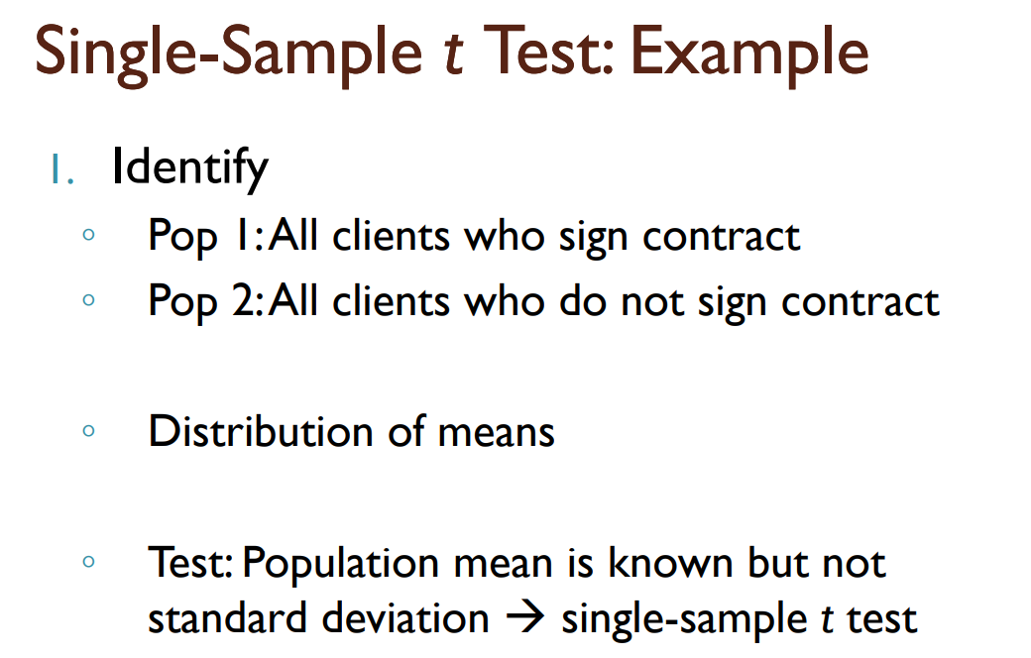

Slide 33
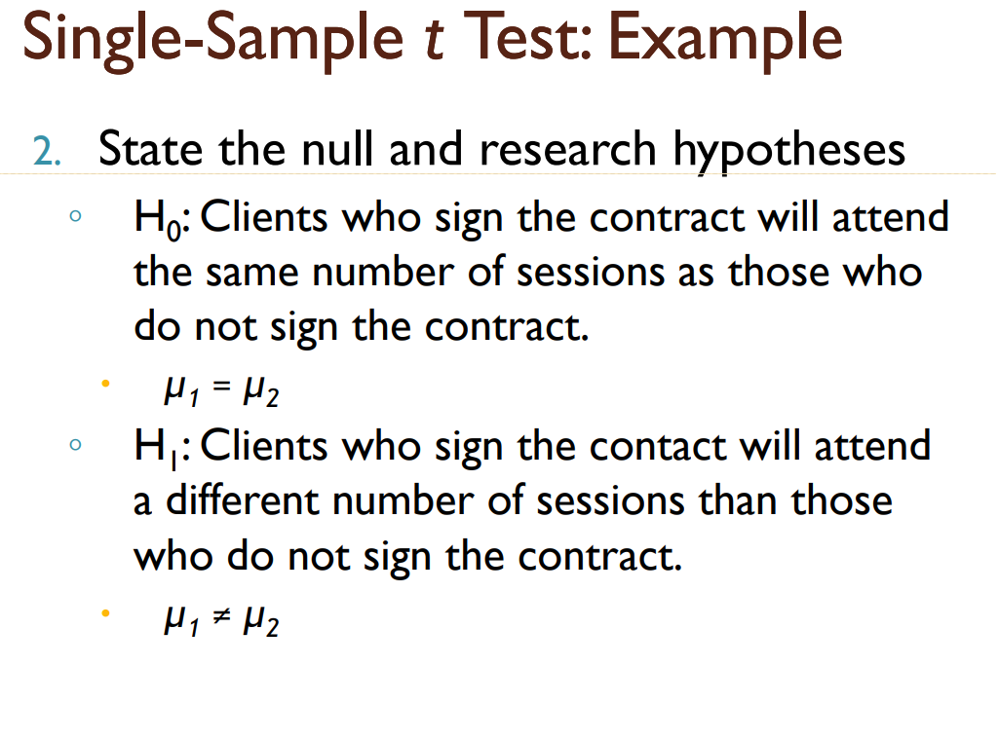

Slide 34
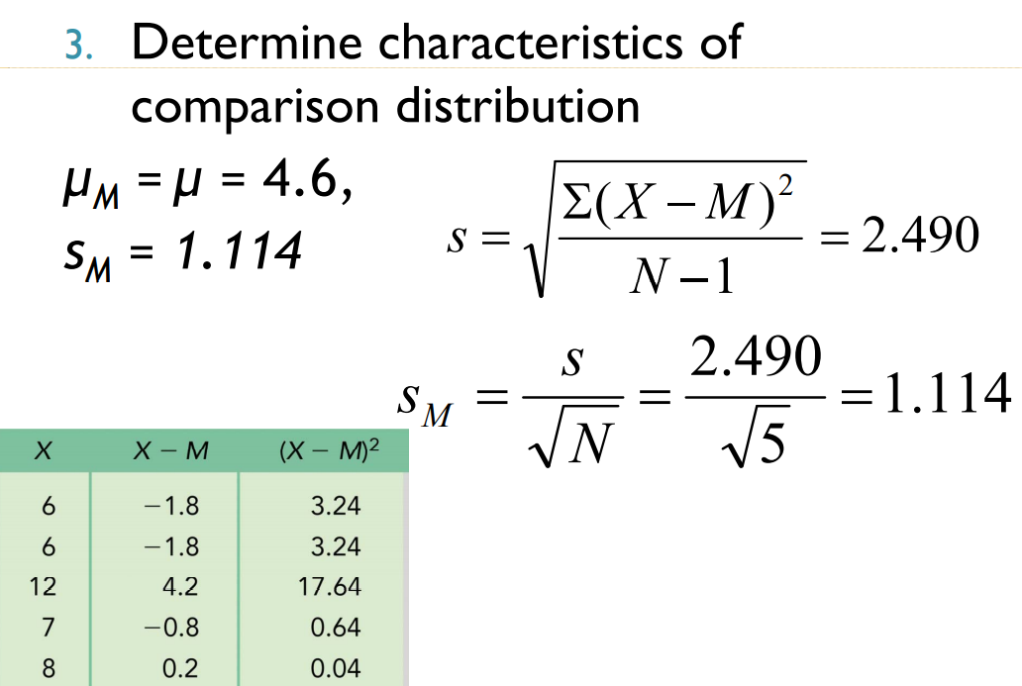

Slide 36
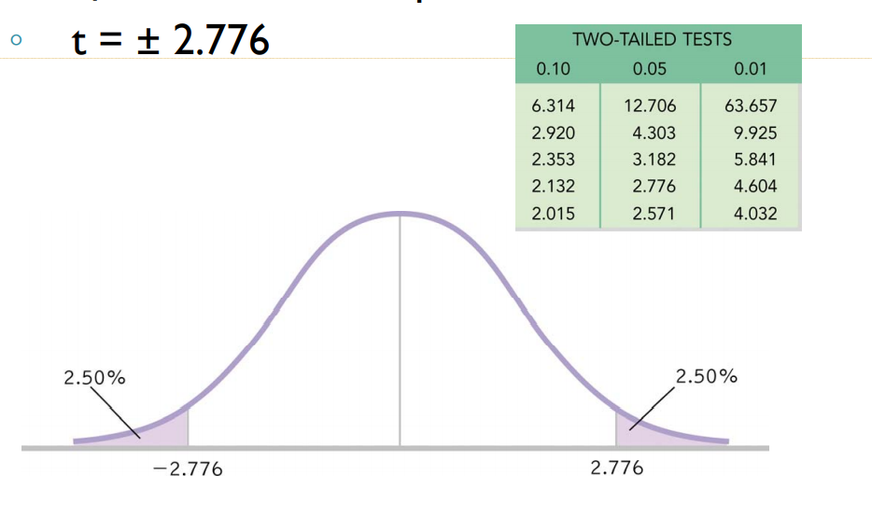

Slide 37
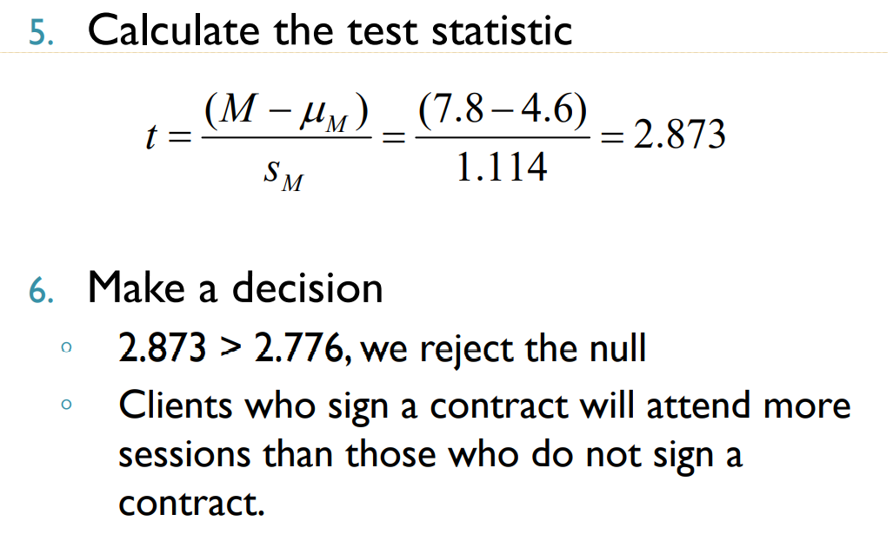

Slide 38
Two sample t-test
Difference
between means
+
Sample size
+
t-test
t
Variability
of data

Slide 39
T-test for difference in means
Given below are the 24 hrs total energy expenditure (MJ/day) in groups of lean and obese women. Examine whether the obese women’s mean energy expenditure is significantly higher ?.
Lean
6.1 7.0 7.5
7.5 5.5 7.6
7.9 8.1 8.1
8.1 8.4 10.2
10.9
Obese
8.8 9.2 9.2
9.7 9.7 10.0
11.5 11.8 12.8

Slide 40
T-test for difference in means
Null Hypothesis
Obese women’s mean energy expenditure is equal to the lean women’s energy expenditure.
Test statistics :
Degree of Freedom
t(n1+n2-2)
1, 2 - means of sample 1 and sample 2
1, 2 – sd of sample 1 and sample 2
n1 , n2 – number of study subjects in sample 1 and sample 2

Slide 41
T-test for difference in means
Data Summary
lean Obese
N 13 9
8.10 10.30
S 1.38 1.25
tab t =9+13-2 =20 df = t _{0.05,20} =2.086
Inference : The cal t (3.82) is higher than tab t at 0.05, 20. ie 2.086 . This implies that there is a evidence that the mean energy expenditure in obese group is significantly (p<0.05) higher than that of lean group

Slide 43
Paired Sample t Test
Study of how 15 volunteers performed on a set of tasks under two conditions:
Using a 15-inch computer monitor compared to using a 42-inch monitor
X | Y
122 | 111
134 | 116
127 | 113
123 | 110
132 | 121

Slide 44
Step 1: Identify the populations, distribution, and assumptions.
Population 1: People doing tasks using a 15-inch monitor.
Population 2: People performing tasks using a 42-inch monitor.
The distribution: a distribution of mean difference scores.
Assumptions: The participants were not randomly selected so we must be cautious with respect to generalizing our findings.
We do not know whether the population is normally distributed.

Slide 45
Step 2: State the null and research hypotheses.
Null hypothesis: People who use a 15-inch screen will complete a set of tasks in the same amount of time, on average, as people who use a 42-inch screen.
H0: μ1=μ2
Research hypothesis: People who use a 15-inch screen will complete a set of tasks in a different amount of time, on average, from people who use a 42-inch screen.
H1: μ1 ≠ μ2

Slide 46
Step 3: Determine the characteristics of the comparison distribution.
M_{difference} = -11

Slide 47
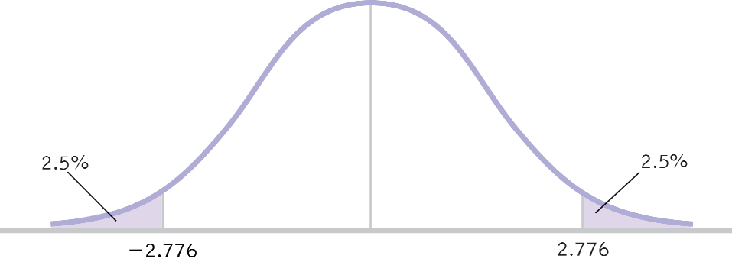
Step 4: Determine the critical values, or cutoffs..
df = N - 1 = 5 - 1 = 4
The critical values, based on a two-tailed test and a p level of 0.05, are 2.776 and 2.776.

Slide 48
Step 5: Calculate the test statistic.
Step 6: Make a decision.
Reject the null hypothesis.

Slide 49
Chi-squared test statistic
The chi-squared test is used when we want to see if two categorical variables are related
The test statistic for the Chi-squared test uses the sum of the squared differences between each pair of observed (O) and expected values (E)
the chi-square test for goodness of fit and the chi-square test for independence.
Notes:
This is an optional slide if your session allowed time for this to be included and shows how the chi-squared test statistic compares the observed and expected.

Slide 50
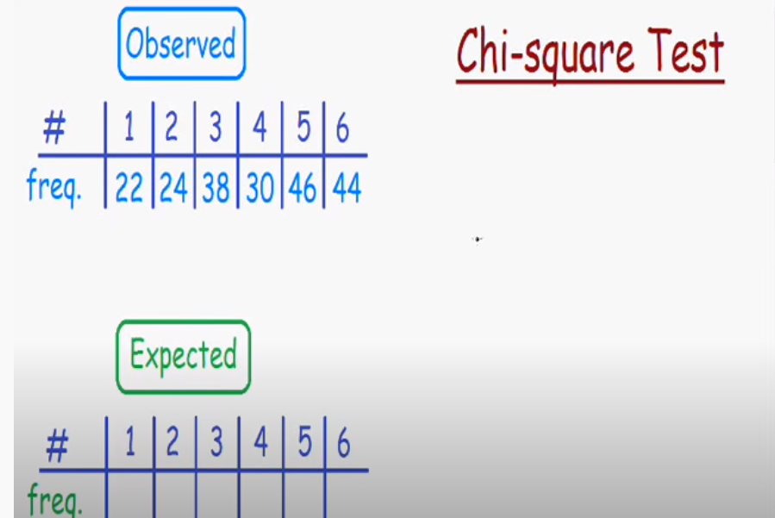
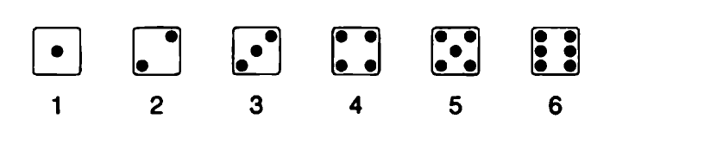
A die is thrown n times the below table shows the frequency of observed data. Find whether the die is fair or not. With (alpha value =0.05)

Slide 51
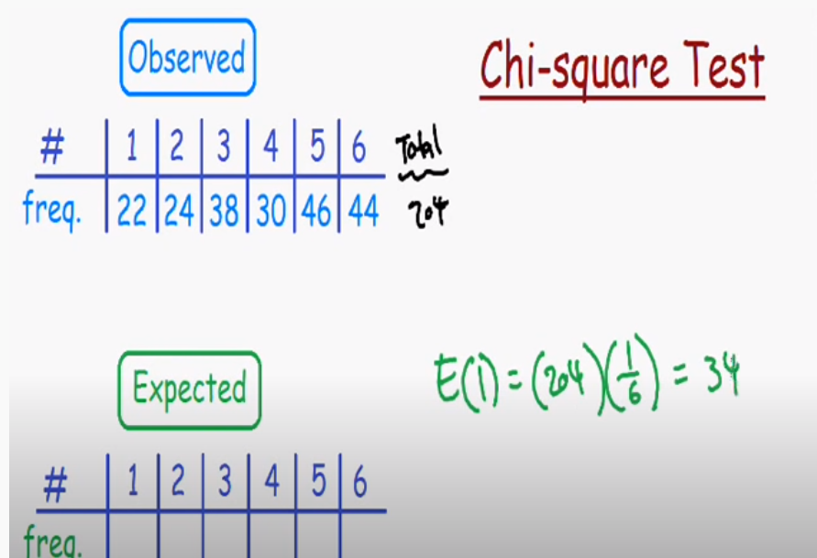

Slide 52
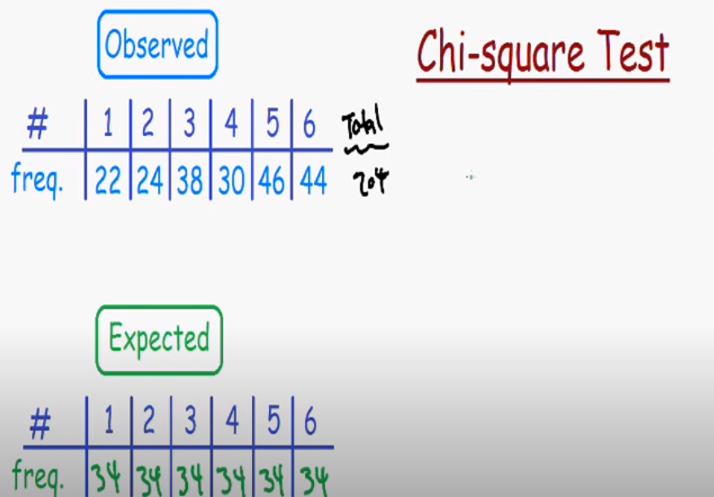

Slide 54
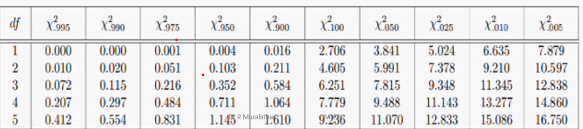
Chi-square table

Slide 55
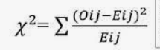
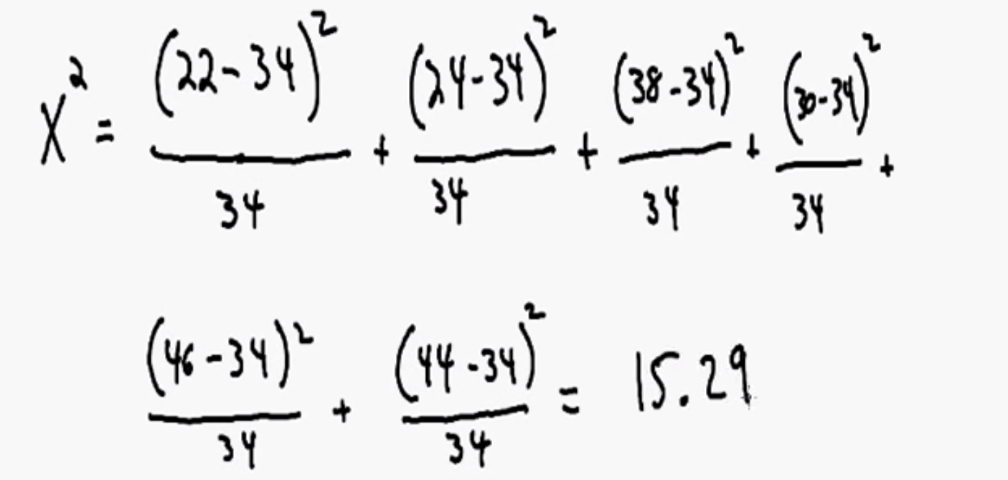
15.29<12.83 So H0 is rejected.

Slide 56
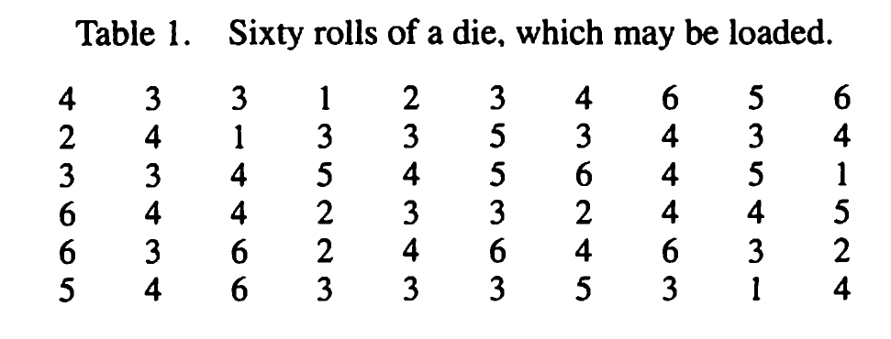
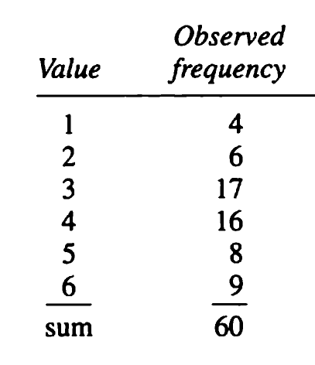
Observed frequencies
Roll the die n = 60 times.
The sample average is 3.75;
but we are interested in the total distribution

Slide 57
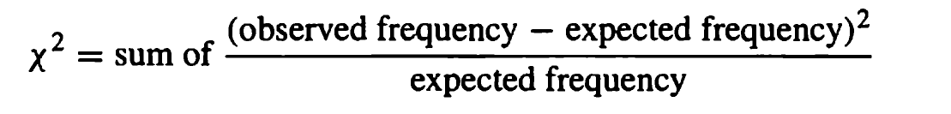
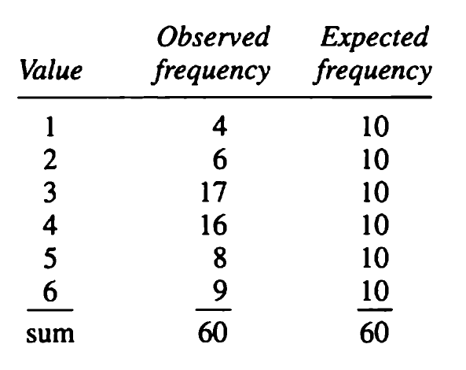
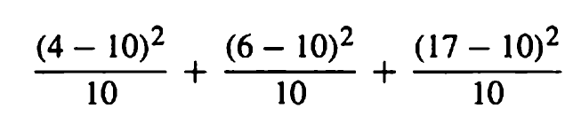
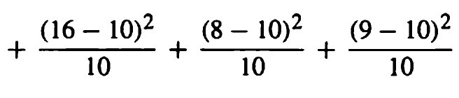
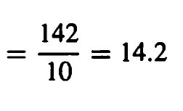
Pearson’s Chi-squared statistic
= 14.2

Slide 58
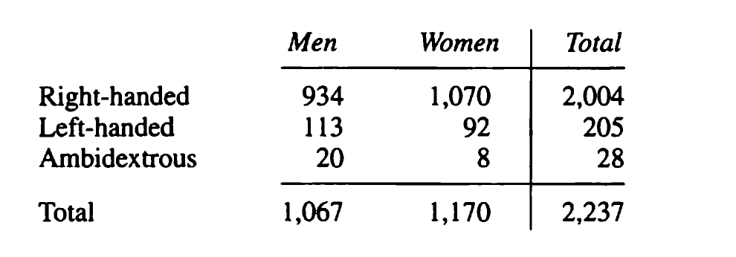
Calculating Expected Values
Null hypothesis: Gender and Handedness are independent
P(man and left-handed) = P(man) x P(left-handed)

Slide 59
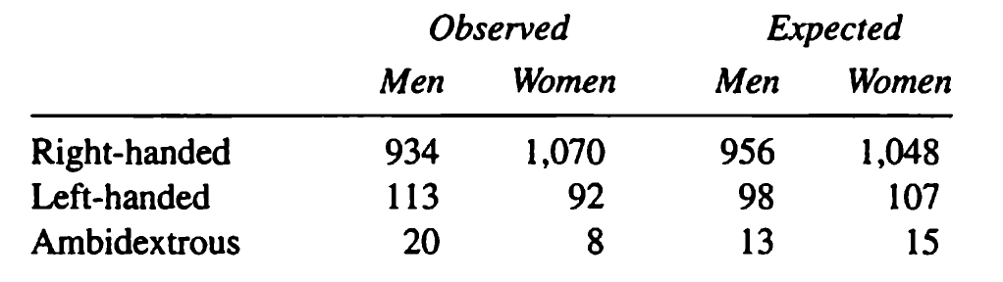
Observed and Expected Frequencies

Slide 60
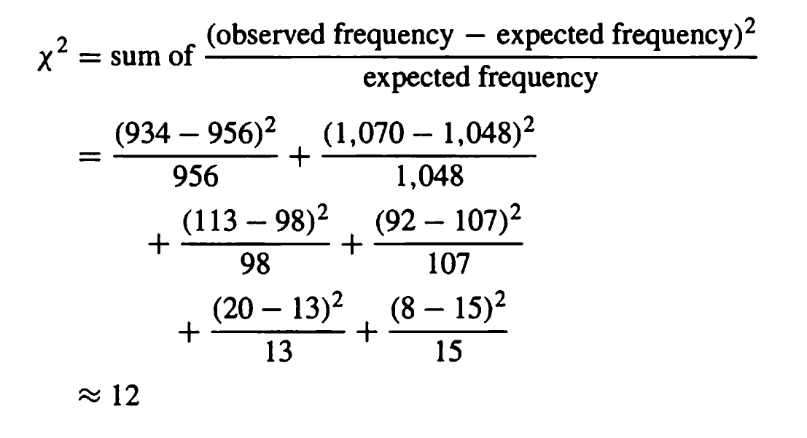
Chi-squared = 12

Slide 61
Degrees of freedom = 2
Degrees of freedom for m x n table = (m - 1) x (n – 1)
Degrees of freedom in 3 x 2 table = 2 x 1 = 2

Slide 62
Chi-square table

Slide 63
Conclusion
Null hypothesis:
“Handedness and gender are
independent”
Chi-squared = 12
Degrees of freedom = 2
Small P-value:
The Null hypothesis is rejected:
handedness and gender are very likely
not independent

Slide 64
F-Distribution or One way Anova
Let represent the sample variances of two different populations. If both populations are normal and the population variances are equal, then the sampling distribution of
is called an F-distribution. There are several properties of this distribution.
The F-distribution is a family of curves each of which is determined by two types of degrees of freedom: the degrees of freedom corresponding to the variance in the numerator, denoted d.f._{N}, and the degrees of freedom corresponding to the variance in the denominator, denoted d.f._{D}.
Continued.

Slide 65
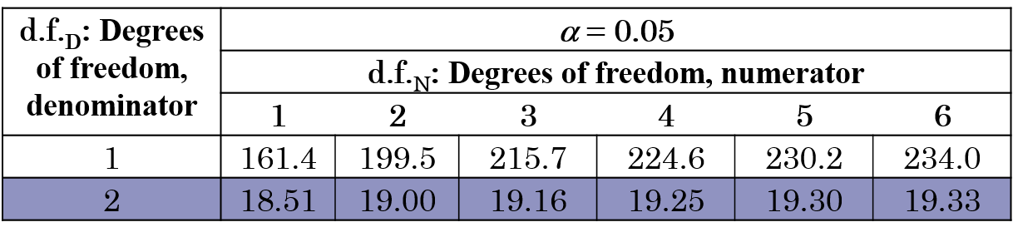
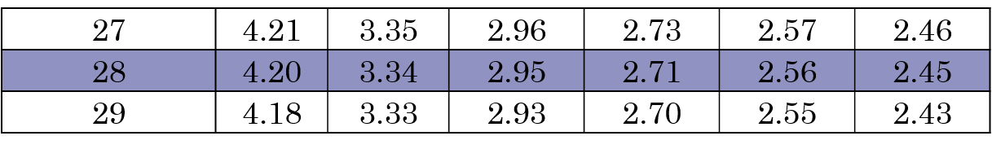
Critical Values for the F-Distribution
Example:
Find the critical F-value for a right-tailed test when α = 0.05, d.f._{N} = 5 and d.f._{D} = 28.
Appendix B: Table 7: F-Distribution
The critical value is F₀ = 2.56.

Slide 66
Two-Sample F-Test
Example:
A travel agency’s marketing brochure indicates that the standard deviations of hotel room rates for two cities are the same. A random sample of 13 hotel room rates in one city has a standard deviation of $27.50 and a random sample of 16 hotel room rates in the other city has a standard deviation of $29.75. Can you reject the agency’s claim at α = 0.01?
Because 29.75 > 27.50,
H₀: (Claim)
H_{a}:
Continued.

Slide 67
Two-Sample F-Test
Example continued:
This is a two-tailed test with α = ( 0.01) = 0.005, d.f._{N} = 15 and d.f._{D} = 12.
The critical value is F₀ = 4.72.
F₀ = 4.72
The test statistic is
F
1
2
3
4
Fail to reject H₀.
There is not enough evidence at the 1% level to reject the claim that the standard deviation of the hotel room rates for the two cities are the same.

Slide 68
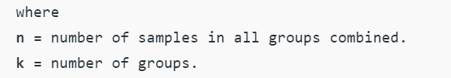
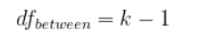
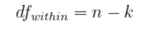
ANOVA
ANOVA is a parametric statistical technique that helps in finding out if there is a significant difference between the mean of two or more groups.
Steps
1. Define the null and alternative hypothesis.
H0 -> μ1 = μ2 = μ3 (where μ = mean)
Ha -> At least one difference among the means.
2. Find the degree of freedom between and within the groups.

Slide 69
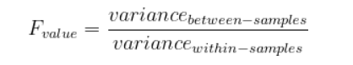
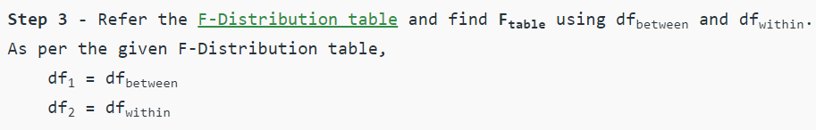
It is defined as the ratio of the variance between samples to variance within samples. It is obtained while performing ANOVA test

Slide 70



Slide 71


Slide 72


Slide 73


Slide 74




Slide 75



Slide 76


Slide 77

ANOVA Test
Example:
The following table shows the salaries of randomly selected individuals from four large metropolitan areas. At α = 0.05, can you conclude that the mean salary is different in at least one of the areas? (Adapted from US Bureau of Economic Analysis)
Continued.

Slide 78
Example continued:
H₀: μ₁ = μ₂ = μ₃ = μ₄
H_{a}: At least one mean is different from the others. (Claim)
Because there are k = 4 samples, d.f._{N} = k – 1 = 4 – 1 = 3.
The sum of the sample sizes is
N = n₁ + n₂ + n₃ + n₄ = 5 + 5 + 5 + 5 = 20.
d.f._{D} = N – k = 20 – 4 = 16
Using α = 0.05, d.f._{N} = 3, and d.f._{D} = 16,
the critical value is F₀ = 3.24.
Continued.

Slide 79
Example continued:
To find the test statistic, the following must be calculated.

Slide 80
Example continued:
Test statistic
Critical value
1.870 < 3.24.
Fail to reject H₀.
There is not enough evidence at the 5% level to conclude that the mean salary is different in at least one of the areas.

Slide 81

Maximum likelihood
The goal of maximum likelihood is to fit an optimal statistical distribution to some data.
This makes the data easier to work with, makes it more general, allows us to see if new data follows the same distribution as the previous data, and lastly, it allows us to classify unlabelled data points.
Lets call the overall set of parameters for the distribution θ. In our case this includes the mean and the variance for each feature. What we want to do now is obtain the parameter set θ that maximises the joint density function of the data vector; the so called Likelihood function L(θ). This likelihood function can also be expressed as P(X|θ), which can be read as the conditional probability of X given the parameter set θ.

Slide 82

Imagine a binary classification problem between male and female individuals using height. Once we have calculated the probability distribution of men and woman heights, and we get a new data point (as height with no label), we can assign it to the most likely class, seeing which distribution reports the highest probability of the two

Slide 83



